Slide 1
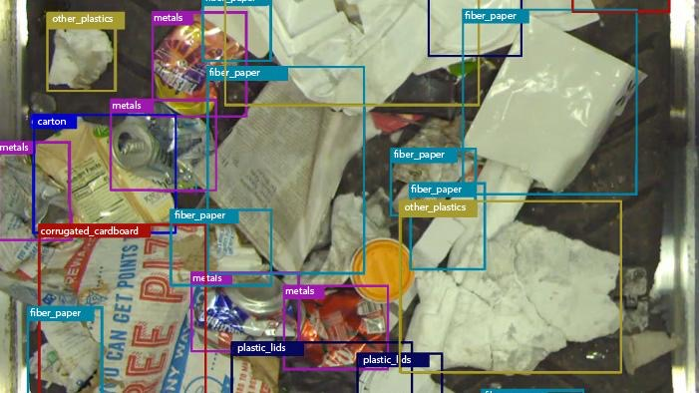


Reimagining Recycling
Applying AI and Robotics to Change the Economics of Material Recovery
5/12/21

Slide 2
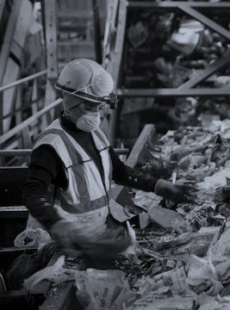



Material Recovery: Industry Challenges
MRFs are now tackling chronic industry challenges using data and automation
High sortation costs that erode the value of scrap commodities
Rapidly evolving tons of material, challenging material quality, resale value, and loss to landfill
Chronic labor shortages, injury risk, and high turnover
2
Notes:
We view material recovery facilities as the hub of recovery for many types of material.
In the United States for example, there are many thousands of municipal recycling programs nationwide, that are collecting material generated by millions of people.
Between the collection and actual recycling of the commodities, there really are a small number of MRFs, thus these facilities are centralized material hubs.
A major challenge is that MRFs incur high costs when attempting to sort out commodities that continue to evolve with complex form factors and material compositions.
Today’s MRFs require a tremendous amount of manual labor, and may incur high residue loss and continuous challenges to ensure high bale quality.
The value of scrap commodities are eroded by the high costs of sorting.

Slide 3
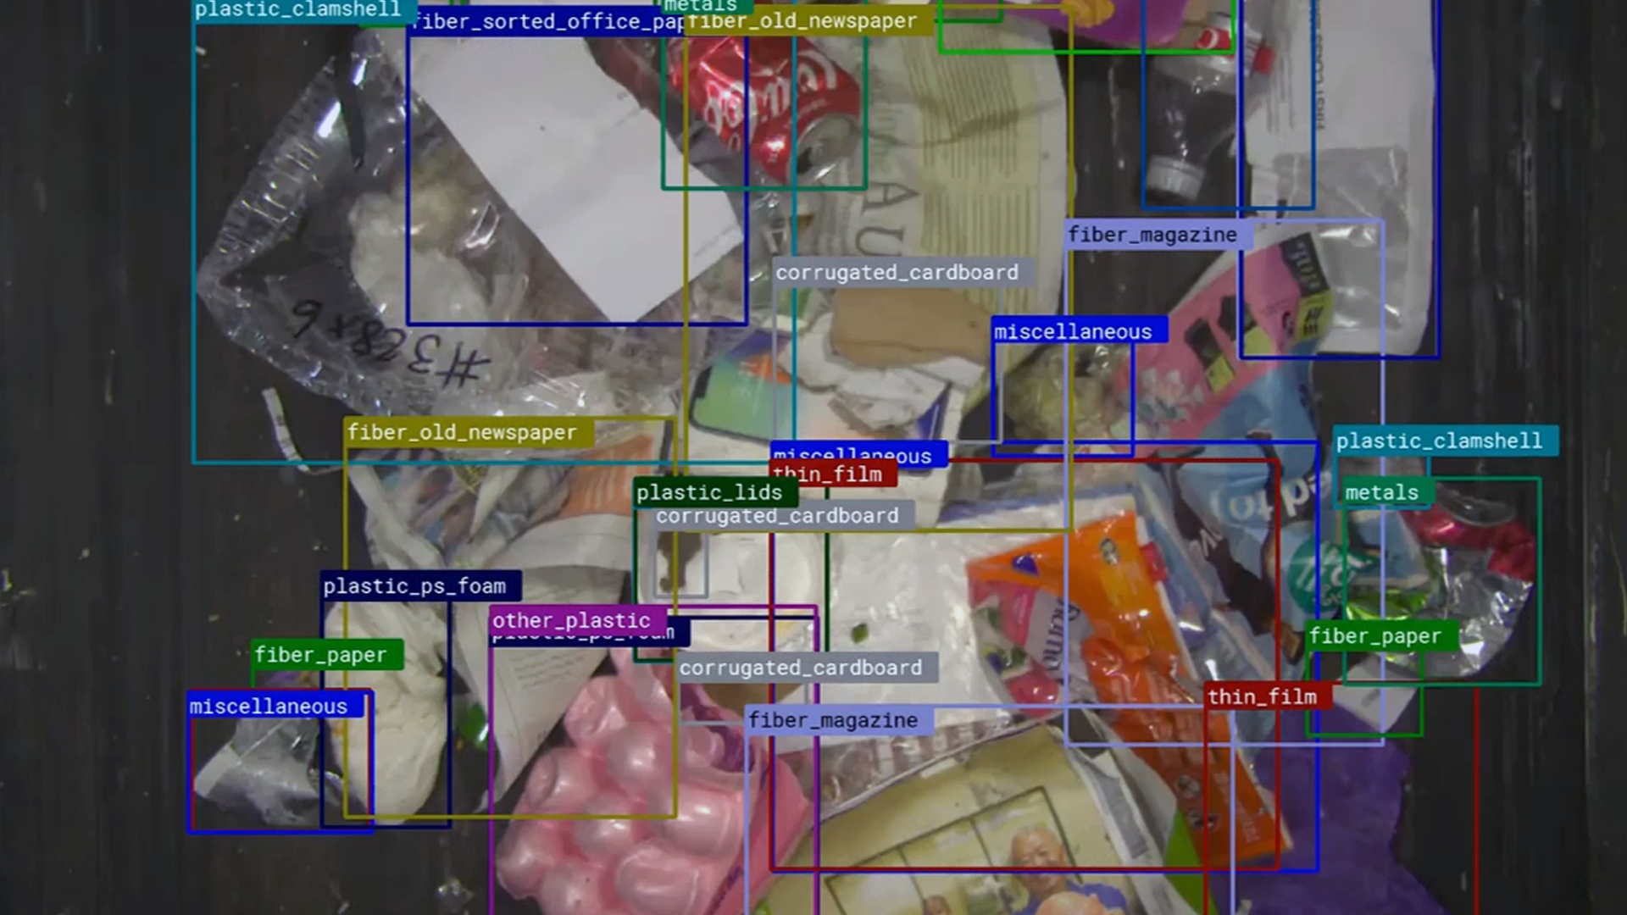

Our Mission
Drive down the cost of sortation, improve operational efficiency, and increase the recovery of high-value commodities using data and automation
© 2020 AMP Robotics. Confidential. www.amprobotics.com
3
Notes:
At AMP, we’ve made it our mission to develop cutting-edge technology to drive down the cost of sortation and provide the tools necessary to improve operational efficiency and elevate recovery rates of high-value commodities.
This is all made possible by using data-driven approaches to automation of key elements within facilities.

Slide 4
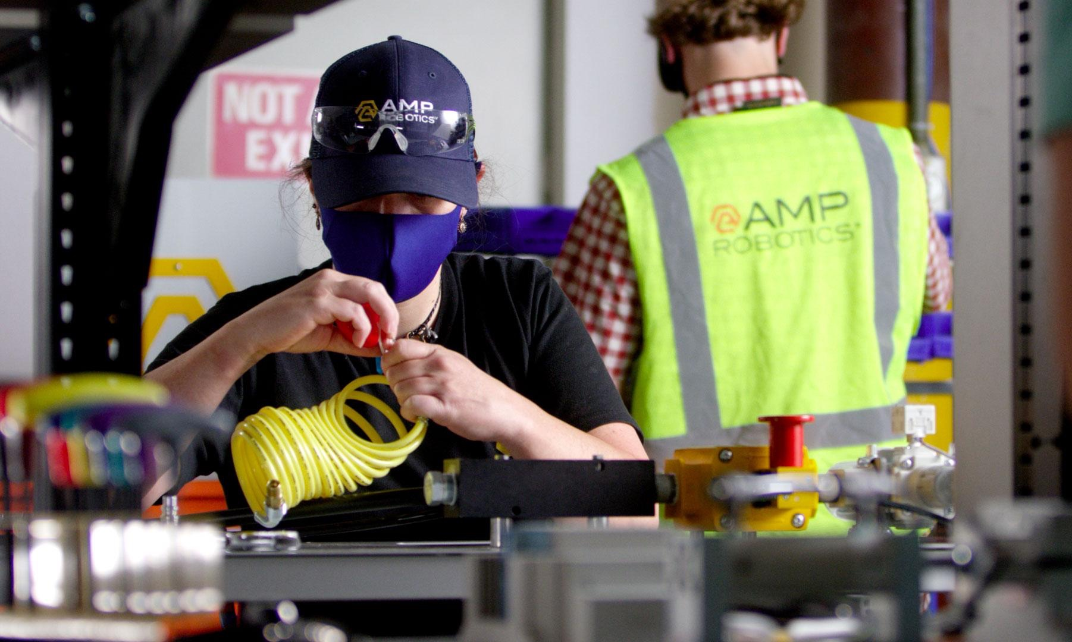





About AMP Robotics
Pioneering AI for Recycling Applications
Founded in 2014 by Matanya Horowitz, PhD
Made in the USA, based in Colorado
Nearly 150 employees with three facilities
Vertically integrated AI and robotics developed by a team of pioneering scientists, engineers and waste industry vets
Applications for C&D, single stream, organics, and e-scrap
125 systems in 25 states in America and internationally
Department of Energy Technology, Idaho National Labs partner
Global investors highly successful scaling industrial technology
4

Slide 5
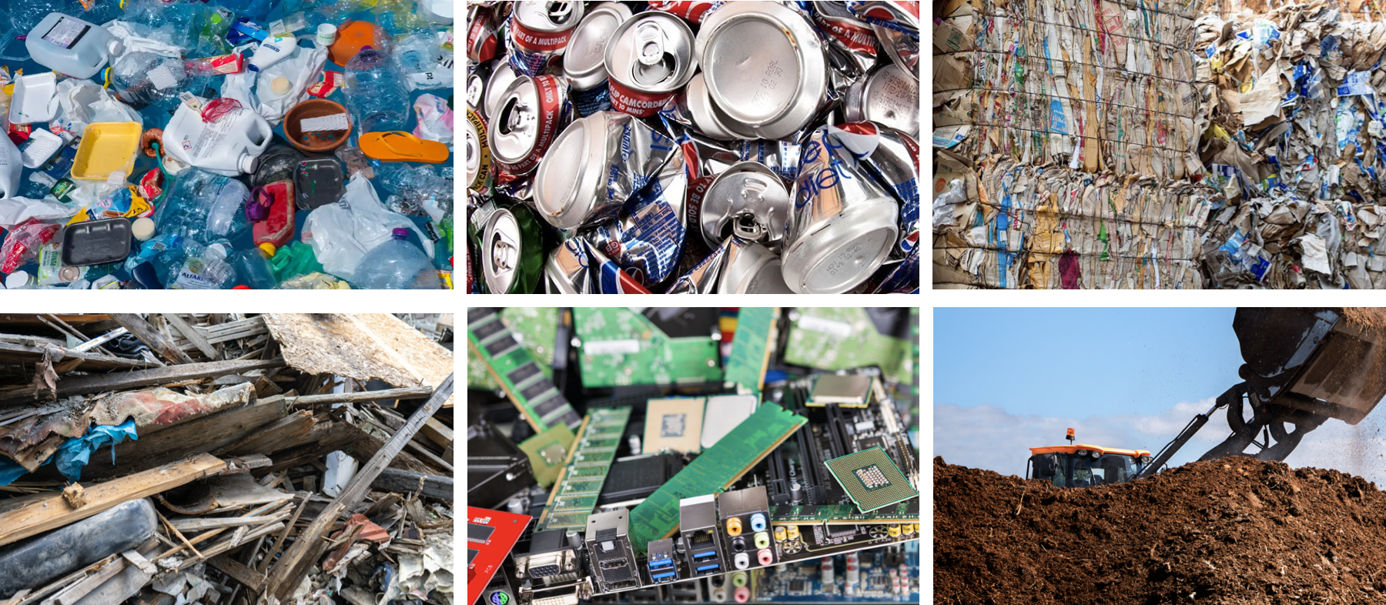
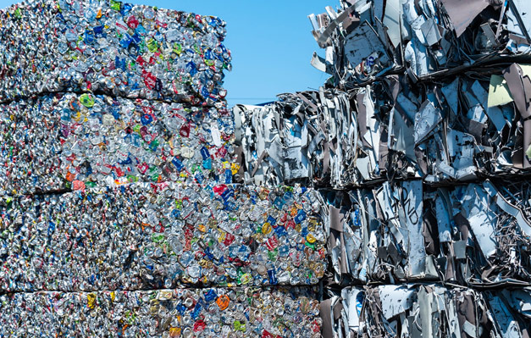
Notes:
We are in multiple material verticals applying our technology across complex waste streams in single stream recycling, e-waste, and organics and are now taking that experience from developing and honing our AI material capture to construction and demolition

Slide 6
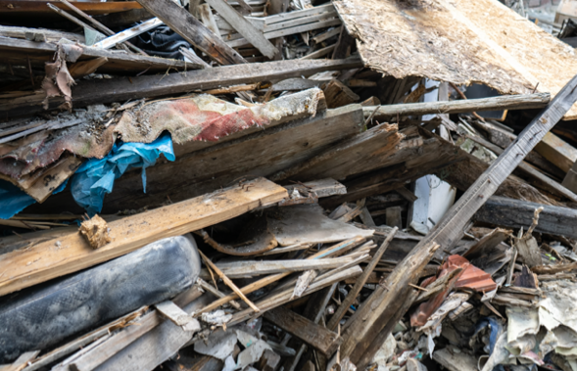
Our Mission
Drive down the cost of sortation, improve operational efficiency, and increase the recovery of high-value commodities using AI-enabled robotics.
© 2020 AMP Robotics. Confidential. www.amprobotics.com
6
Notes:
We have spent the last couple of years developing and field testing our technology for C&D before we entered the market. Our first test bed was in Japan working with a strategic partner called Ryohshin (Ree-OH-shin) on robotics hardware and mechanical sortation of C&D. The robotic hardware is there, but we know it’s all about the accuracy of material identification and the machine learning we needed to bring value to the industry. So after that time working on it, we started developing our AI in earnest with US companies.

Slide 7
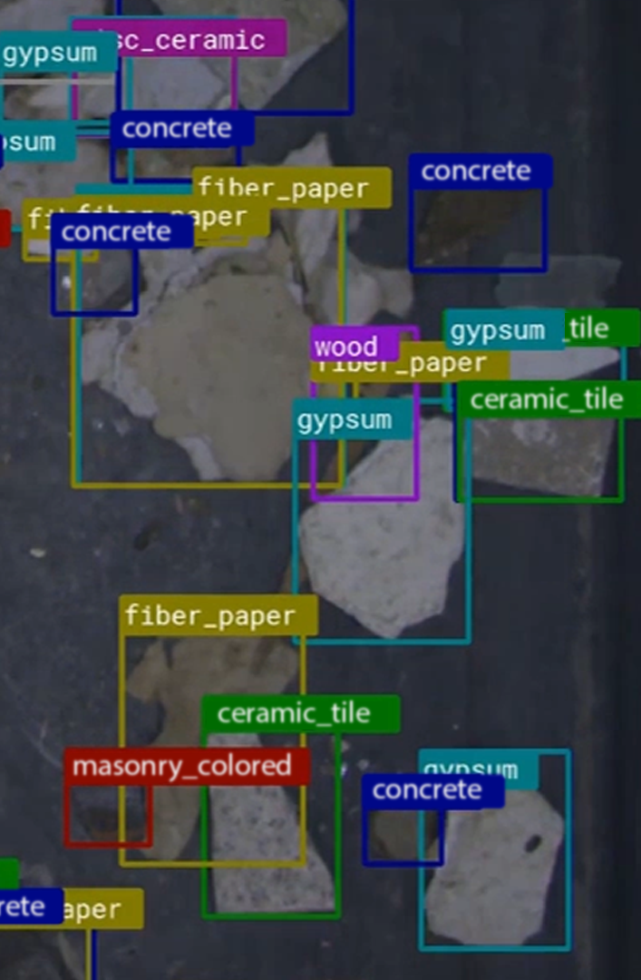
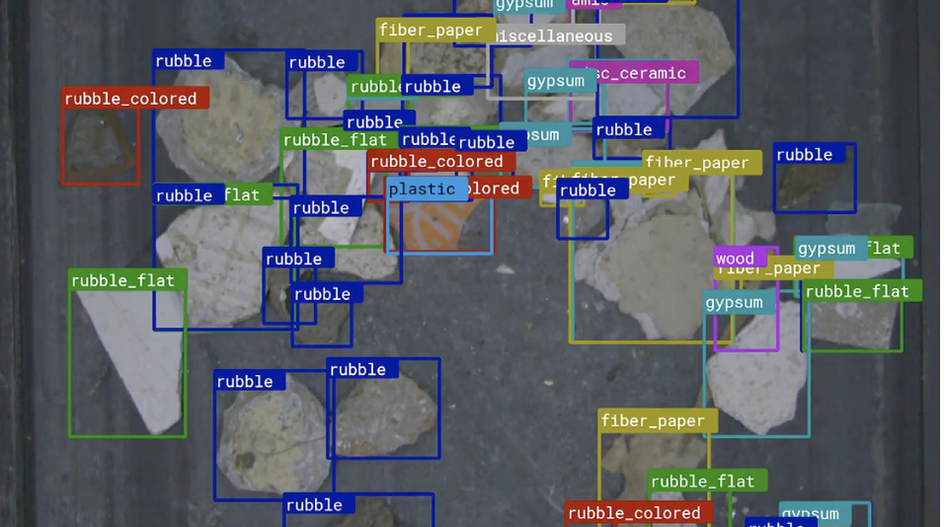
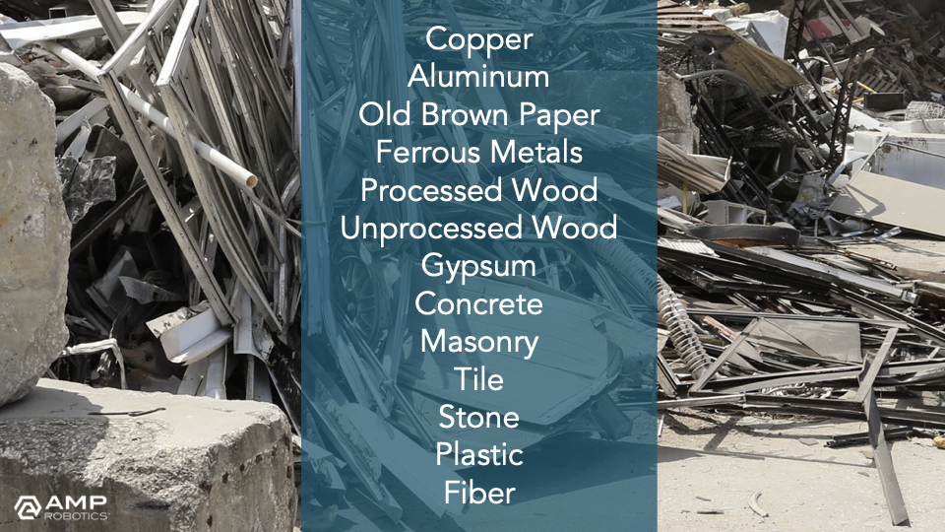
Notes:
In C&D applications, this translates to materials like copper, aluminum, processed and unprocessed wood, gypsum, concrete, and more. In many ways, there are fewer challenges than single-stream applications as size reduction is fairly well maintained in C&D operations. Dust, other environmental factors not significantly different; our systems are designed to withstand the harsh environments you find in these facilities.

Slide 8
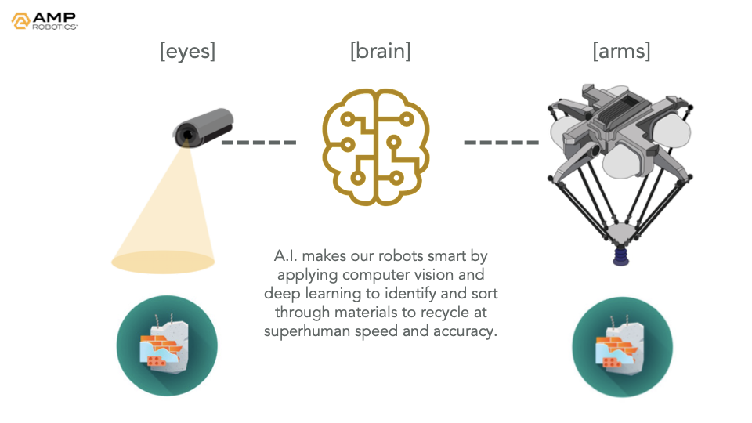
Notes:
So how does it work? AMP Cortex is our high-speed, intelligent robotics system. There are really three components, and you can think of them as the brain, eyes, and arms. Cortex’s computer vision, the eyes, identifies material as it comes down a conveyor to be picked and sorted just as a human would. The brain, our AI platform called AMP Neuron, converts these images into data, capturing and categorizing everything that it recognizes. Then Neuron guides a Delta-style robot to pick and place the material to be recycled. All of this happens at superhuman speed with consistent precision and extremely high accuracy -- allowing us to specialize in material identification of discrete materials in C&D.

Slide 9
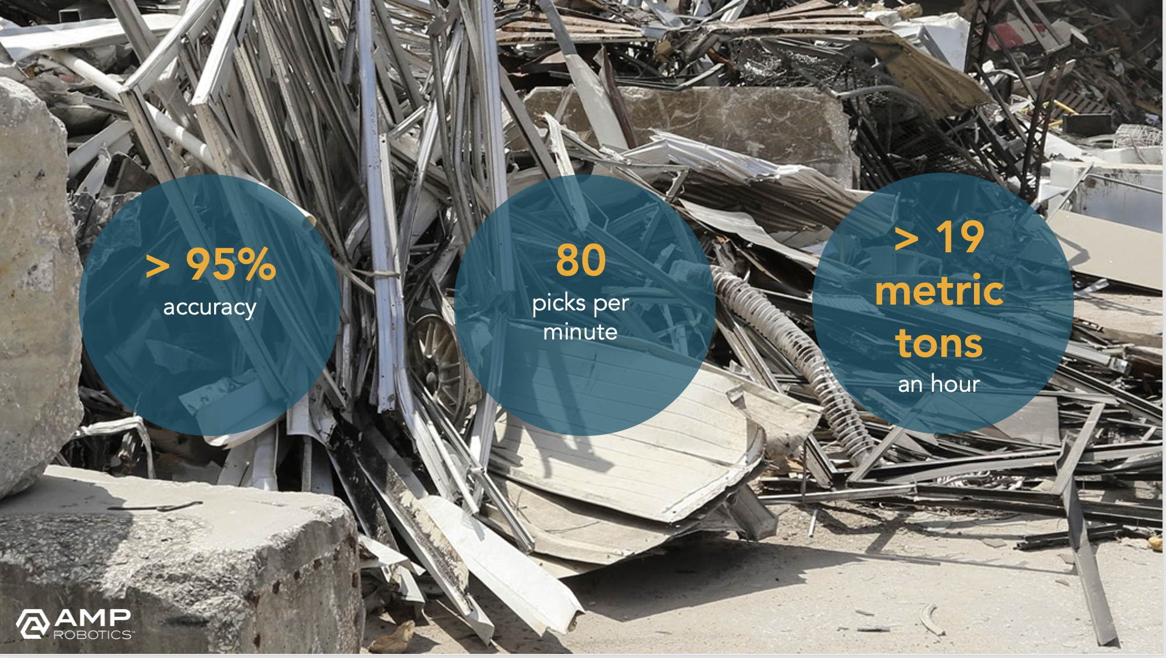
Notes:
Our systems achieve upwards of 80 picks per minute for faster and more precise construction & demolition material recovery. Cortex’s delta-style robots can pick up lighter and smaller objects like wood, metal, drywall and plastics that gantry-style robots with parallel grippers typically miss. AMP Cortex is ideal on C&D material recovery “B lines’’ and can accommodate material size between 2” and 7” in dimension, with a weight limit up to 10 lbs (4.5kg). Material sizing is best ensured through the use of a single shaft style shredder and ballistic separator.
Our systems also benefit from and leverage the power of collective knowledge, meaning the overall intelligence compounds as our fleet expands. Our neural network can continuously be trained to recognize new material, and the knowledge is disseminated across the network: one of our systems operating in Texas learns from another in California and another in New York and so on.
And with a modular design, the system is engineered to fit into existing sorting stations, adjusting to space constraints so you don’t have to worry about costly retrofits or interruptions to your line. Installation is fast and often can be done in 48 hours.

Slide 10
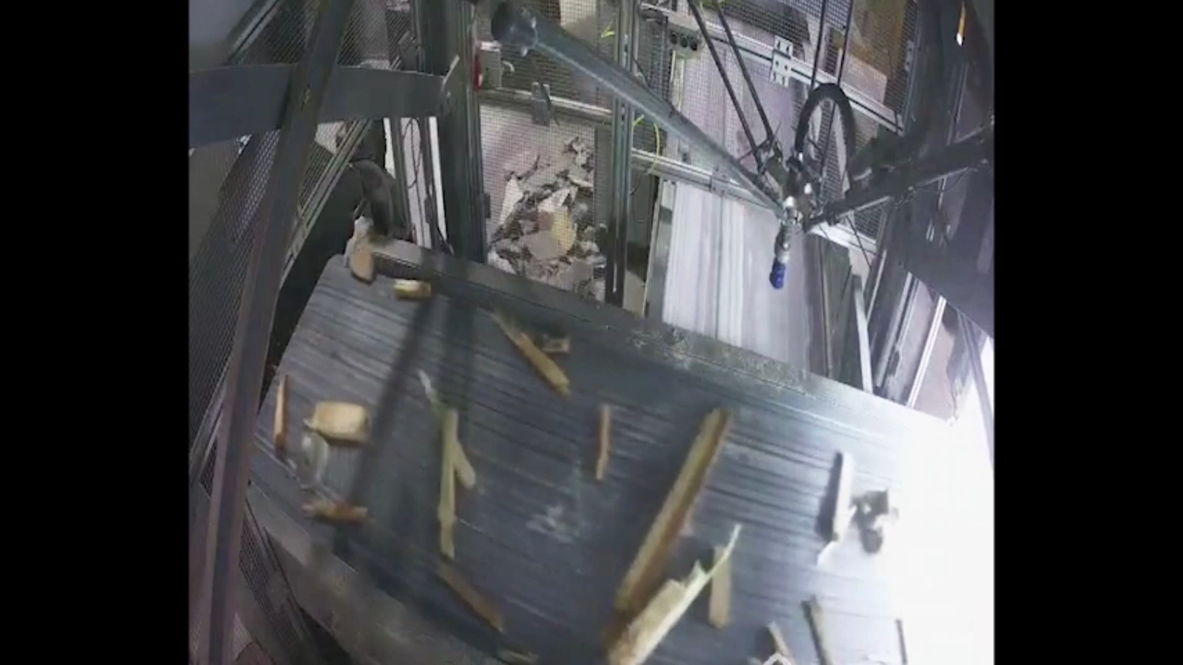

Slide 11
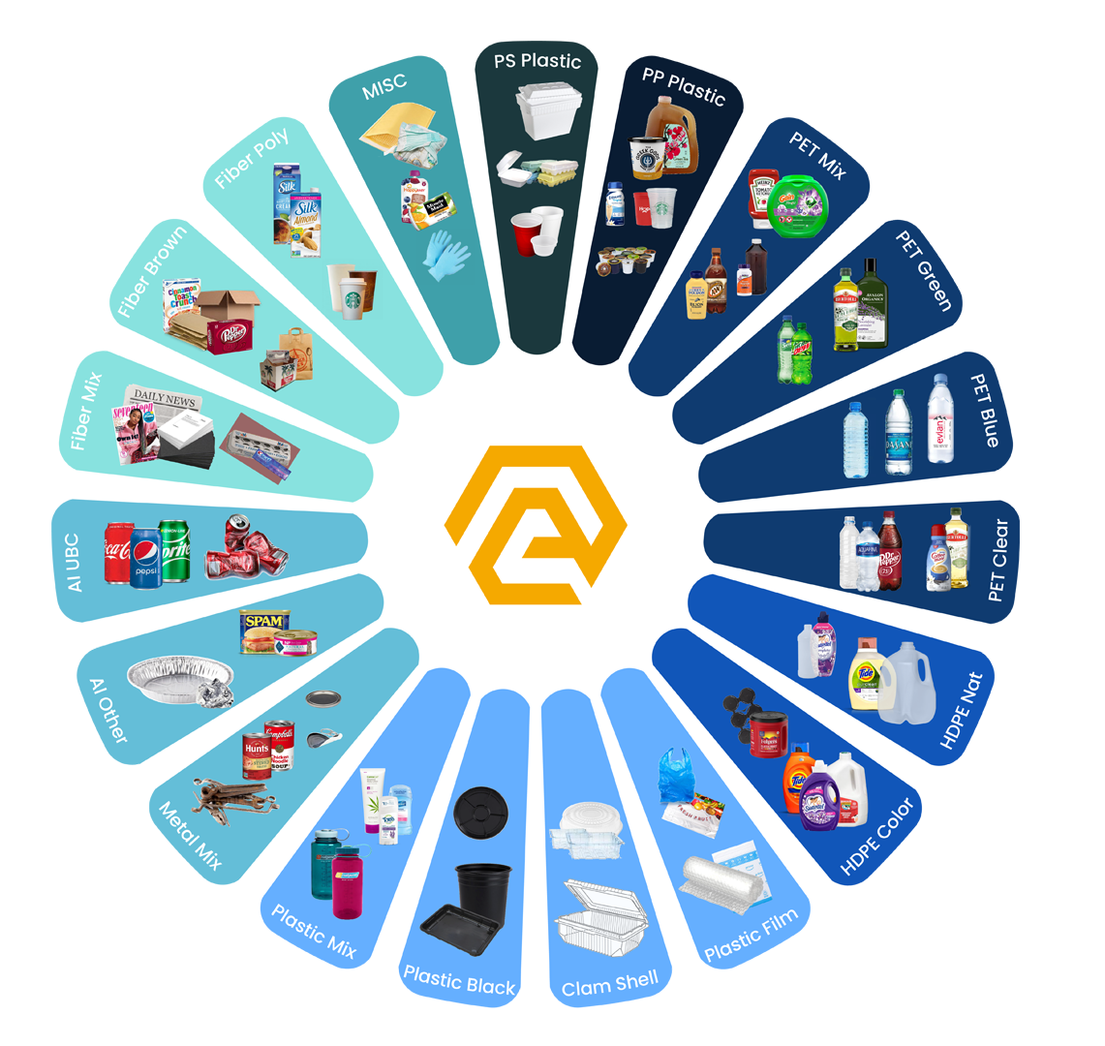
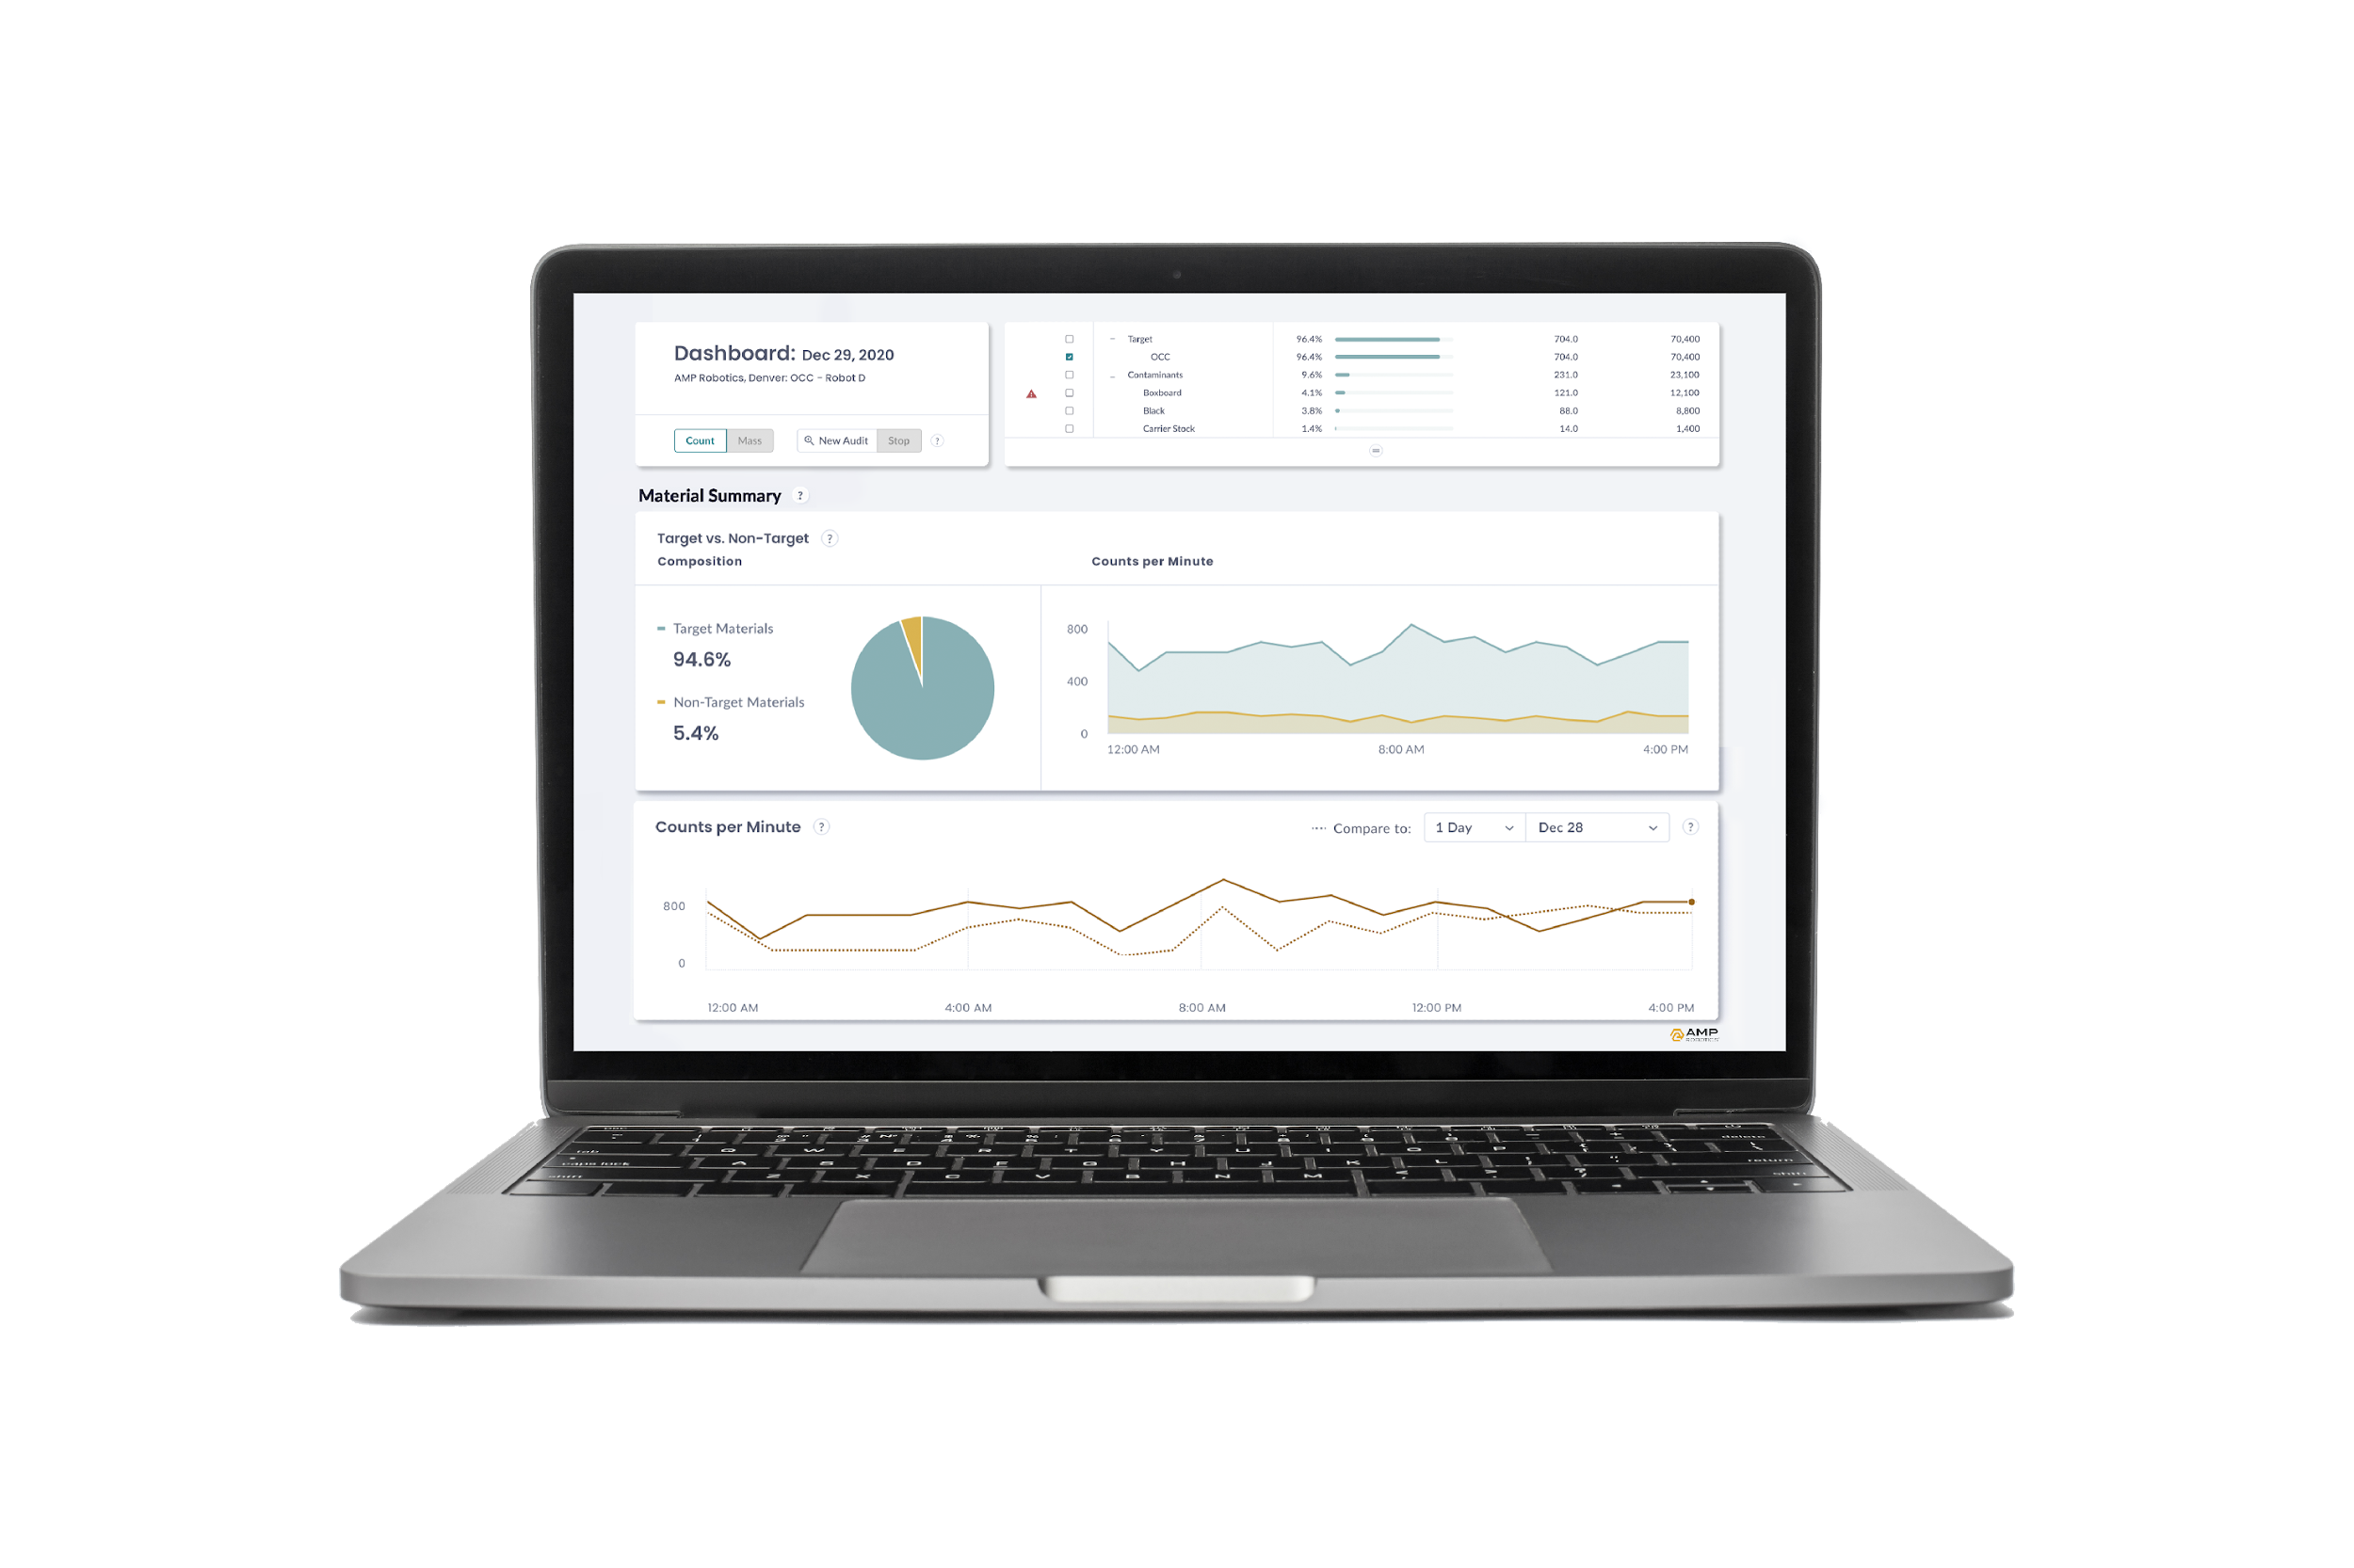
Data: Collection, Monitoring & Audit
Extensive identification and classification by material, form factor, color, and other visual attributes.
11
Notes:
AMP’s AI has digitized each object that passes by, and these objects are captured as data.
This is a new form of data, a new category of data. Including object counts, packaging descriptions, over time.
This can be linked to other types of descriptive data to expand the richness and utility as well.
This is truly material intelligence: Artificial intelligence that identifies and characterizes objects in near real-time.
At AMP, we’ve deployed hundreds of robots and sensors that process billions upon billions of objects for recycling.
This effectively enables automated and continuous characterization of this material.
We continue to expand our material categories by exploring subcategories - such as specific colors of plastics, types of metals, and brand identification - that can be useful for MRFs as well as for downstream recyclers.
The characterization possibilities are quite extensive.

Slide 12
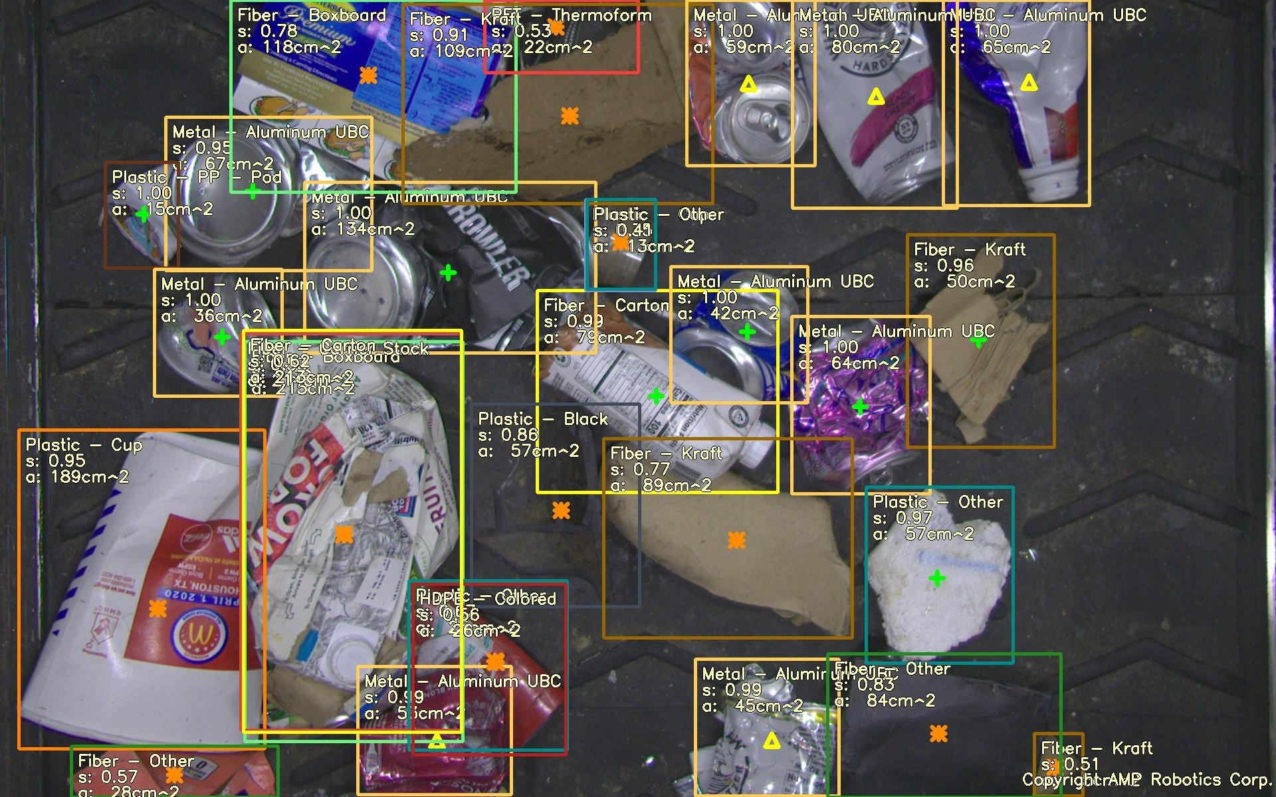
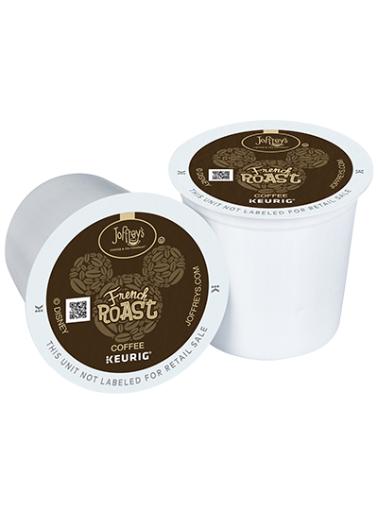
Notes:
One application of this data is AMP’s work with consumer packaged goods to identify specific types of packaging formats and brands within the recycling stream.
Brands are asking questions to ensure the recovery of their packaging formats, and to increase recovery rates of materials that help with their post-consumer content goals.

Slide 13
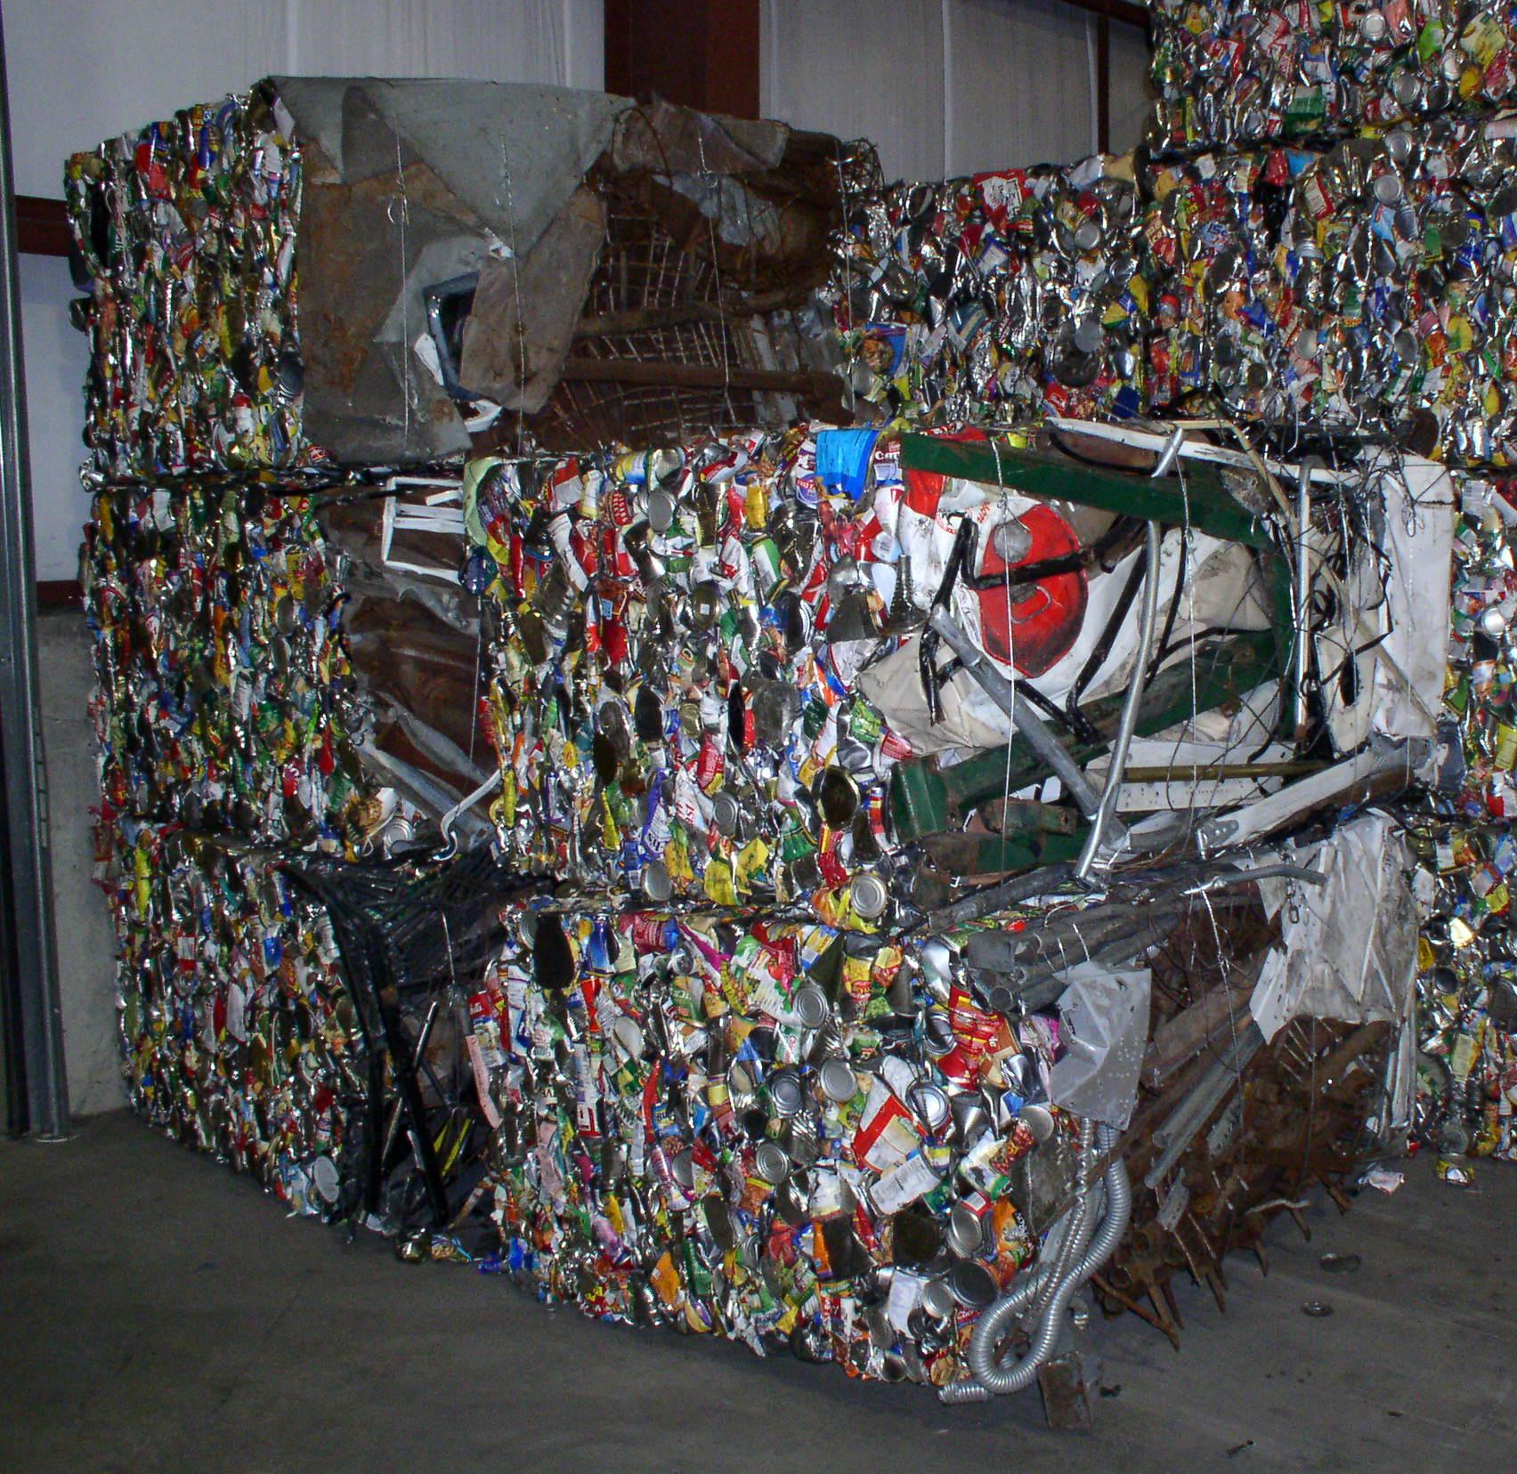
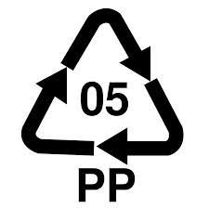
Notes:
A great example of this was our 2020 collaboration with Keurig Doctor Pepper
We worked with Keurig to develop a coffee pod category within the AI identification
This has helped Keurig as it pursued a packaging format change to increase the recovery of coffee pods when these objects enter the recycling stream.
AMP’s robots now actively identify coffee pods, and many customers have configured their robots to harvest pods for scrap plastic bales.
This example highlights the specificity to which AI can perceive material, across a variety of applications, to ensure it’s recovered for the production of high-quality feedstock at lower environmental and economic costs.

Slide 14
Thank you
© 2020 AMP Robotics. Confidential. www.amprobotics.com

